Slide 1
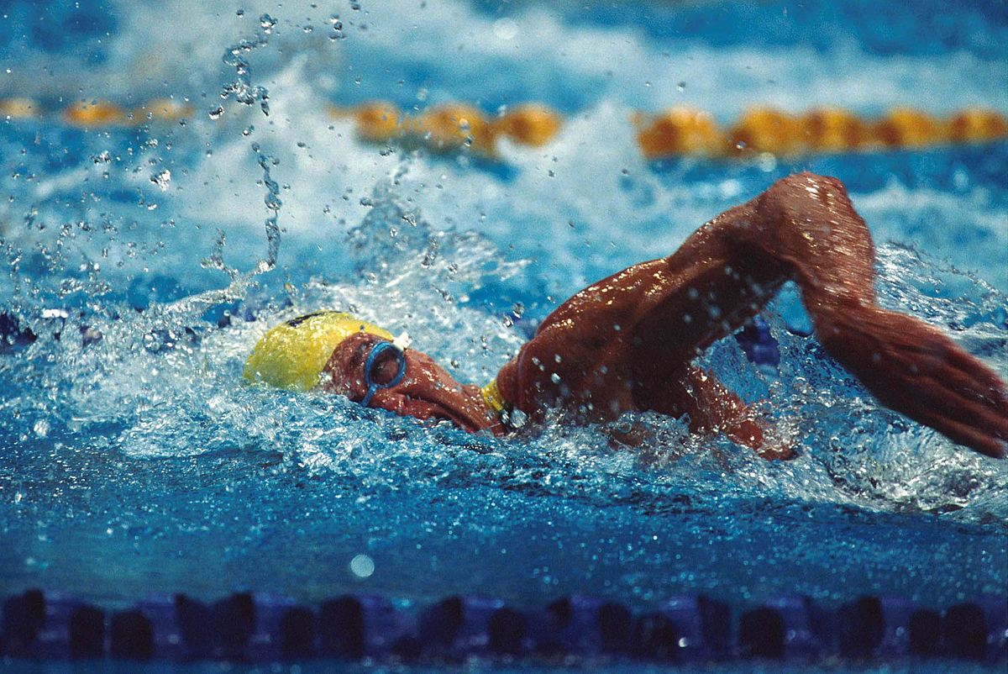
2019-20
WVSSAC Swim Rules Clinic

Slide 2
CONTACT INFORMATION
Cindy Daniel, Ed.D., Assistant Executive Director
304-485-5494 (O) or 304-552-7866 (C)
cindy.daniel@wvssac.org
Scott Wilson, Rules Interpreter
sewjd@aol.com

Slide 3
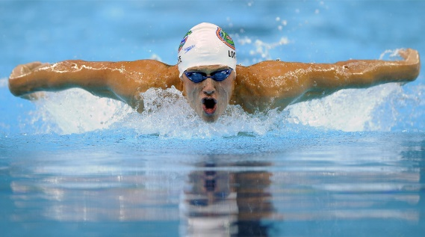
Welcome!
Please complete card – make sure handwriting is legible. Tear off bottom portion of card and keep for your records.
Complete Coach Information Sheet.
Cards/sheet will be collected at the end of the clinic.

Slide 4
REQUIRED READING
Interscholastic
Swim Coaches’ Packet
Sports Medicine Coaches’ Packet
NFHS Swim Rule Book (sent to schools)
Access the documents at www.wvssac.org – click on “Sports” tab, then “Swim”

Slide 5
REQUIRED ONLINE COURSES
Concussion In Sports (annually)
Sudden Cardiac Arrest (annually)
Heat Illness Prevention (one time for new coaches)
All courses are free and can be accessed on the WVSSAC homepage (www.wvssac.org)

Slide 6
REQUIRED – Emergency Action Plan
ALL schools must complete an Emergency Action Plan annually BEFORE THE FIRST DAY OF PRACTICE. Please work with your athletic director and school administrators to make sure it is completed.
Fines up to $250 if not completed by first day of practice.

Slide 7
REQUIRED – AS PER NEW LEGISLATION
Schools must hold an informational meeting for student athletes and parents prior to the beginning of the season regarding the warning signs of sudden cardiac arrest in children.
Schools must submit an online concussion report WITHIN 7 days of the incident for any athlete who is removed from practice or play with a suspected concussion/head injury. Form is on our website.

Slide 8
CONCUSSION RTP PROTOCOL
RTP shall be delayed until the athlete is asymptomatic and has undergone a progression of tests to determine if they are able to RTP. Each step/test in the progression takes 24 hours and no more than one progression per day may be completed.
If any symptoms occur during the progression, the athlete should rest for 24 hours before attempting the same progression again.
No activity with complete physical and cognitive rest.
Light aerobic exercise (less than 70% of maximum heart rate).
Sport specific exercise (drills specific to the athlete’s sport).
Non-contact training drills (more intense sport drills with no contact from other players).
Full contact practice (following medical clearance).
Return to play (normal game play).

Slide 9
Approved Health Care Providers Who Can Evaluate and Release to RTP
Medical Doctor (MD)
Doctor of Osteopathy (DO)
Doctor of Chiropractic (DC)
Advanced Registered Nurse Practitioner (ARNP)
Physician Assistant (PA-C)
Licensed/Registered Certified Athletic Trainer (ATC/R, LAT, ATC)
Licensed Physical Therapist

Slide 10
HEAT ACCLIMATIZATION

Slide 11
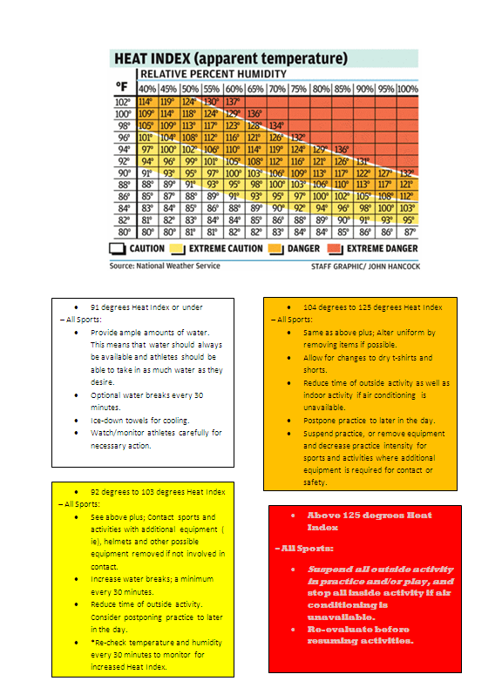

Slide 12
Other Important Information
Non School Participation Rule
Sunday practice activities prohibited
14 days of practice with the school team before first contest
Use of Pool – If 2 or more schools are using same pool – letter requesting permission. Keep separate.
Eligibility
Physical exams – parent and student signature

Slide 13
Out of Season Coaching
3 week window
Flex Days

Slide 14
SEASON DATES
First Practice: October 28
First Contest: November 13
Regional: February 8
State: February 20-21
Regional Entry Form due – February 4 - NOON
Part 1 NFHS - (minimum score 75%) – deadline October 31
State Meet Time Schedule – TBA – See Interscholastic

Slide 15
SANCTIONING
School shall not enter contest/competition which requires sanctioning until it is approved
Applications for sanctioning must be submitted to the SSAC office 30 days prior to the event
An event with more than four school or awards are given require sanctioning
Any event where awards are given require sanctioning

Slide 16
REMINDERS
Athlete grade level (9, 10, 11, 12) required on every entry form
Individual Entry Times (for regular season meets)
Must be from high school meets (current or prior season)
Relay Entry Times
Must be from high school meets from current season
Breaks during state meet – not less than (5) minutes
500 Freestyle qualifying times
7:30.00 Women
6:30.00 Men

Slide 17
Reminders – (Continued)
Schools must schedule in a minimum of 6 meets and an individual swimmer must compete in a minimum of 4 school meets to be eligible for regional competition. Strongly recommend schedule more than 6 because of weather. Schedule must be posted online.
Hy-tek entry will be accepted provided it includes all information on WVSSAC entry form – Due February 4 by noon to WVSSAC. After noon to Regional Directors.

Slide 18
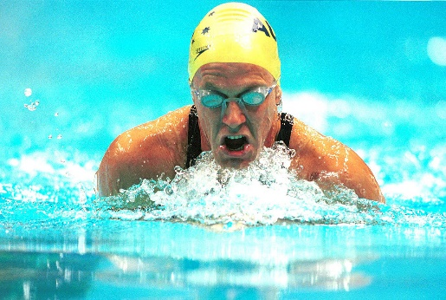
Other
Psyche sheets vs heat sheets
Documentation at regional meet
FINA mark
Rules Chart (handout)
NISCA 2019-20 All America time standards (handout)
Times - high school and club swimmers (handout)
Hytek

Slide 19
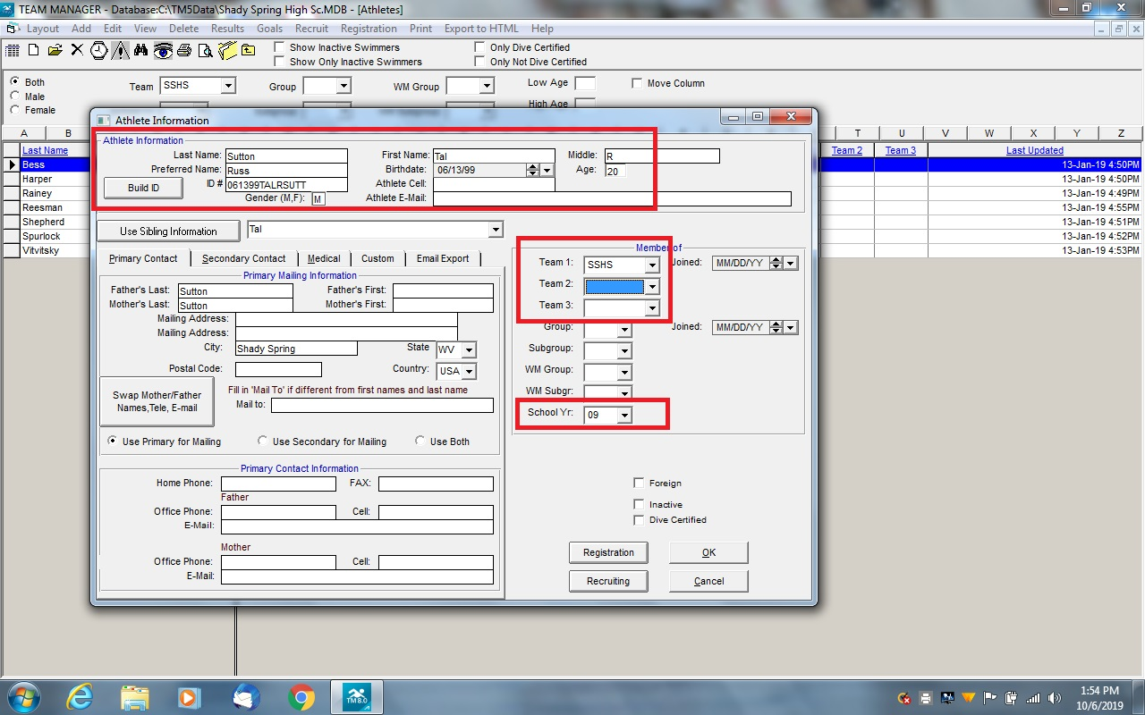

Slide 20
LEGAL DUTIES OF A COACH
Properly plan the activity
Provide proper instruction
Warn of inherent risks
Provide a safe physical environment
Provide adequate and proper equipment
Match athletes appropriately
Evaluate athletes for injury or incapacity
Supervise activity closely
Provide appropriate emergency assistance
Protect against physical and psychological harm from others

Slide 21
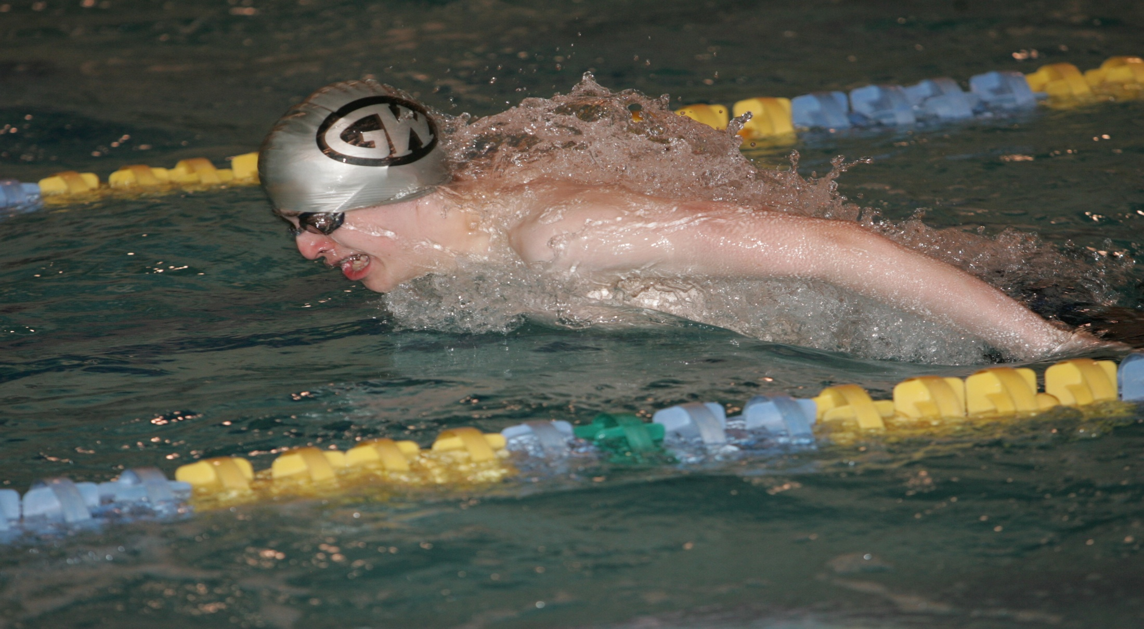
STATE QUALIFIERS
Individual Events:
The top three (3) from each region and the remaining twelve (12) qualifiers will be the next fastest twelve (12) competitors, by time, from all regions combined.
Relays:
The top two (2) from each region and the next 10 fastest times. This will only occur if all regionals use automatic timing. If a team qualifies 7 or more athletes, no alternate is permitted.
If a team qualifies fewer than 7 athletes (which at least one must be a relay), the coach must fill out the form and request to bring ONE alternate. (This form MUST be sent to the WVSSAC by the Monday following the regional meet.)

Slide 22
Parade of Finals
Coach of top seeded swimmer will choose from a list of preapproved music
Members of the coaches committee will provide a preapproved list of music to the WVSSAC for top seeded athletes to select.
The list will be included in your state meet packet

Slide 23
OFFICIALS PART 1 EXAM
WVSSAC Website – www.wvssac.org
Must have an email address
OFFICIAL login
Testing window – (minimum score 75%)
Instructions are in packet
Self nomination deadline – February 1, 2020
For any questions, contact Alice Goodwin – alice.goodwin@wvssac.org or 304-485-5494.

Slide 24
OFFICIALS PATCH
To be worn on the left breast of the official’s shirt (stitched, ironed or Velcro.)
May also have an embroidery logo as long as on a white polo and done by Officials Call.
For additional information, contact Chuck Leach with “The Officials Call”

Slide 25
Required Officials’ Apparel
White – golf/polo shirt, short sleeve with collar, 2-4 buttons
Navy Blue – long pants, shorts, skirts
White – athletic shoes (no sandals or crocs)
White socks
WVSSAC officials patch or embroidery only (left breast)

Slide 26
New Venue for State Meet – Mylan Park Aquatic Center

Slide 27
QUESTIONS?

Slide 28
THANKS FOR YOUR ATTENTION!

