Slide 1
2019-20 NFHS Swimming and diving Rules PowerPoint
Rules Changes Major Editorial Changes
Points of Emphasis

Slide 2
NFHS Rules Book as e-Books
E-books features:
Searchable
Highlight areas of interest
Make notes
Easy navigation
Adjustable viewing size
Immediate availability
Notes:
The NFHS Rules and Case Book e-books are available for $6.99 each.

Slide 3
NEW NFHS Rules App
Rules App features:
Searchable
Highlight notes
Bookmarks
Quizzes for all sports
Easy navigation
Immediate availability
Free to paid members of the NFHS Coaches and Officials Associations
www.nfhs.org/erules for more information
Notes:
Rules Book Apps for all NFHS rules books and case books are available on iTunes and Google Play. Rules books and case books are cross-linked and enabled for searchable content.

Slide 4
Guidelines for Schools and state associations for consideration of accommodations
Notes:
To assist state associations in working with schools for the inclusion of students with disabilities, the following guide prepared by the NFHS Task Force on the Inclusion of Students with Disabilities is being provided for your review.
Following these guidelines will assist in the individual student assessment by the student and the school.
When requesting a possible accommodation, coaches should work with their school and the state association as early as possible in the sport season.
Contest officials shall defer decisions on rule accommodations to the respective state association.
This information serves as a guide. Each state association may develop its own process.

Slide 5
2019-20 nfhs swimming and diving
Rule Changes

Slide 6
Uniforms 3-3-1, 3-3-2, 3-3-2 PENALTIES, 3-3-3, 3-3-3 and 3-3-4 PENALTIES
Rule 3-3 has been reorganized to identify penalties for specific uniform violations. No other changes were made to these rules.
Rule 3-3-1 recommends that all swimmers and divers wear suits of identical coloring and pattern.
Notes:
Rule 3-3 was reorganized to identify penalty protocol for specific uniform violations. No other changes were made to these rules.
Rule 3-3-1 recommends that all swimmers and divers wear suits of identical coloring and pattern.
Rationale: Specific rules related to suit coverage, what can be placed on the uniform, and suit construction have not changed. Penalties associated with violations of Rule 3-3 were simply reorganized to provide clear indication of when the coach and/or the competitor should be notified. All language concerning suit coverage was moved from 3-3-1 to 3-3-2. As a result, the new Rule 3-3-1 recommends, not mandates, that swimmers and divers wear suits of similar coloring and pattern.

Slide 7
Uniforms 3-3-1, 3-3-2, 3-3-2 PENALTIES, 3-3-3, 3-3-3 and 3-3-4 PENALTIES
Rule 3-3-2 contains all language addressing suit coverage:
Suits shall be of one piece;
A competitor shall not be permitted to participate wearing a suit that is not of decent appearance;
Boys shall wear suits which cover the buttocks and shall not extend above the waist or below the top of the kneecap;
Girls shall wear suits which cover the buttocks and breasts and shall not extend beyond the shoulders or below the top of the kneecap, nor cover the neck.
Notes:
Rule 3-3-2 contains all language addressing suit coverage:
Suits shall be of one piece;
A competitor shall not be permitted to participate wearing a suit that is not of decent appearance;
Boys shall wear suits which cover the buttocks and shall not extend above the waist or below the top of the kneecap;
Girls shall wear suits which cover the buttocks and breasts and shall not extend beyond the shoulders or below the top of the kneecap, nor cover the neck.
Rationale: All current language addressing suit coverage previously contained in Article 1 and 3 now resides in Rule 3-3-2, which applies to all swimmers and divers. Again, no language regarding uniform compliance was changed in Rule 3-3.

Slide 8
Uniforms 3-3-1, 3-3-2, 3-3-2 PENALTIES, 3-3-3, 3-3-3 and 3-3-4 PENALTIES
3-3-2 PENALTIES
When an official discovers a competitor wearing illegal attire as described in Article 2, the official shall:
When observed prior to the start of the heat/dive, notify the coach of the competitor to make the swimsuit legal;
When observed after the heat/dive officially begins, disqualify the competitor at the completion of the heat/dive;
Notes:
3-3-2 PENALTIES When an official discovers a competitor wearing illegal attire as described in Article 2, the official shall:
when observed prior to the start of the heat/dive, notify the coach of the competitor to make the swimsuit legal;
when observed after the heat/dive officially begins, disqualify the competitor at the completion of the heat;
Rationale: Penalties associated Rule 3-3-2 rule were reorganized to provide clear indication of when the coach should be notified. When a violation is observed before the start of the heat or dive, the official must notify the competitor’s coach, not the competitor. If the competitor cannot comply without delaying the start of the heat/ dive, the competitor is disqualified from that event/dive and shall not be eligible for further competition until in a legal suit. When a violation is observed after the heat or dive officially begins, the competitor is disqualified at the completion of the heat or dive, the competitor's performance time/score is nullified and he/she shall not be eligible for further competition until in a legal suit.

Slide 9
Uniforms 3-3-1, 3-3-2, 3-3-2 PENALTIES, 3-3-3, 3-3-3 and 3-3-4 PENALTIES
Rule 3-3-3 addresses information that can be placed on the suit or cap:
Competitor’s name, school name, school nickname or logo;
Advertising or name other than that permitted in 3-3-2c is prohibited;
Size of a single visible manufacturer’s logo/trademark/reference;
Size of one American flag or memorial patch;
The FINA mark and/or individual barcode.
Notes:
Rule 3-3-3 addresses information that can be placed on the suit or cap:
Competitor’s name, school name, school nickname or logo;
Advertising or name other than that permitted in 3-3-2c is prohibited;
Size of a single visible manufacturer’s logo/trademark/reference;
Size of one American flag or memorial patch;
The FINA mark and/or individual barcode.
Rationale: Specific rules related to what can be placed on the uniform are contained in Rule 3-3-3 and have not changed. School information, manufacturer’s logo size, and size of the American flag and/or the memorial patch are specified. Rule 3-3-3 applies to all competitors, meaning both swimmers and divers.

Slide 10
Uniforms 3-3-1, 3-3-2, 3-3-2 PENALTIES, 3-3-3, 3-3-3 and 3-3-4 PENALTIES
Rule 3-3-4 addresses suit construction for swimmers (excluding divers):
Constructed of a woven/knit textile material;
Must be permeable except for one post-construction, school name and/or logo not to exceed 9 square inches;
May not aid buoyancy;
May not have fastening systems other than a waist tie for a brief or jammer and elastic material in the terminal ends.
Notes:
Rule 3-3-4 addresses suit construction for swimmers (excluding divers):
Constructed of a woven/knit textile material;
Must be permeable except for one post-construction, school name and/or logo not to exceed 9 square inches;
May not aid buoyancy;
May not have fastening systems other than a waist tie for a brief or jammer and elastic material in the terminal ends.
Rationale: Specific rules related to suit construction for swimmers are contained in Rule 3-3-4 and have not changed. Suit construction rules regarding material, permeability, buoyancy or fastening systems are not applicable to suits for divers.

Slide 11
Uniforms 3-3-1, 3-3-2, 3-3-2 PENALTIES, 3-3-3, 3-3-3 and 3-3-4 PENALTIES
Rule 3-3-3 and 3-3-4 PENALTIES: When an official discovers a competitor wearing illegal attire as described in Articles 3 and 4, the official shall:
When observed prior to the start of the heat/dive, notify the coach or the competitor to make the swimsuit legal;
When observed after the heat/dive officially begins, disqualify the competitor at the completion of the heat;
Notes:
Rule 3-3-3 and 3-3-4 PENALTIES: When an official discovers a competitor wearing illegal attire as described in Articles 3 and 4, the official shall:
When observed prior to the start of the heat, notify the coach or the competitor to make the swimsuit legal;
When observed after the heat officially begins, disqualify the competitor at the completion of the heat;
Rationale: In situations which a violation of Rule 3-3-3 or 3-3-4 occurs, the official may notify the coach or the competitor. When a violation is observed prior to the start of the heat/dive, the official should notify the coach or the competitor to make the attire legal before becoming eligible to compete. If the competitor cannot comply without delaying the start of the heat/ dive, the competitor is disqualified from the event/dive and shall not be eligible for further competition until in legal attire. When a violation is observed after the heat/dive officially begins, the official shall disqualify the competitor at the completion of the heat/dive, nullify the competitor's performance time and he/she shall not be eligible for further competition until in legal attire.

Slide 12
Uniforms 3-3-1, 3-3-2, 3-3-2 PENALTIES, 3-3-3, 3-3-3 and 3-3-4 PENALTIES
The remaining articles have been renumbered:
Rule 3-3-5 addresses speed, buoyancy, body compression and adhesives.
Rule 3-3-6 requires coaches to verify that all competitors are legally attired.
Notes:
The remaining articles have been renumbered:
Rule 3-3-5 addresses speed, buoyancy, body compression, adhesives.
Rule 3-3-6 requires coaches to verify that all competitors are legally attired.
Rationale: Rule 3-3-5 and 3-3-6 were renumbered and no changes were made to this language.

Slide 13
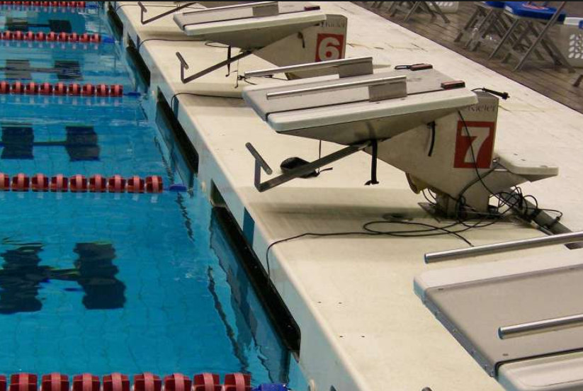
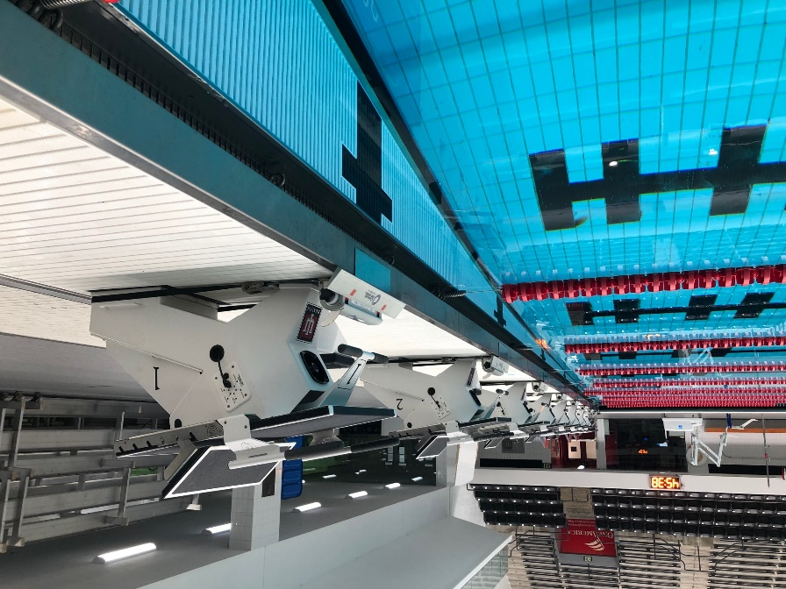
finishes 8-1-7, 8-2-1g, 8-2-2h, 8-2-3g, 8-2-4e
Rule 8-1-7: To finish the race, the swimmer shall contact the finish end in the manner prescribed by the stroke.
Notes:
Rule 8-1-7: To finish the race, the swimmer shall contact the finish end in the manner prescribed by the stroke.
Rationale: Previous language requiring the competitor to contact the touchpad or end wall between the lane lines where the touch pad should be located when in the proper position was removed. A legal finish now requires the competitor to contact either the touchpad or the finish end according to the finish rules pertaining to the stroke being swum. The rule no longer requires the touchpad to be contacted when electronic timing is used, provided the competitor contacts the finish wall as prescribed by the rules applicable to that stroke.

Slide 14
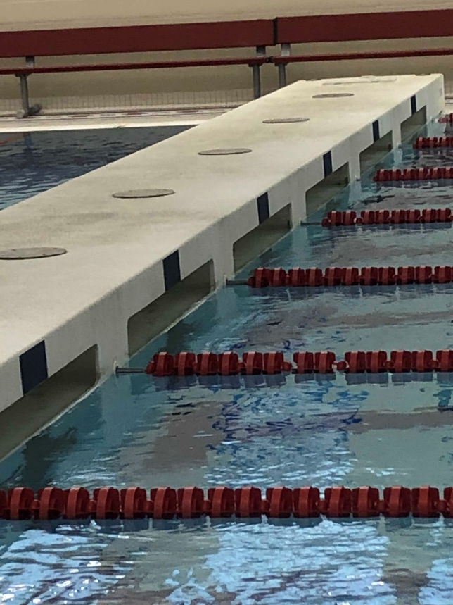
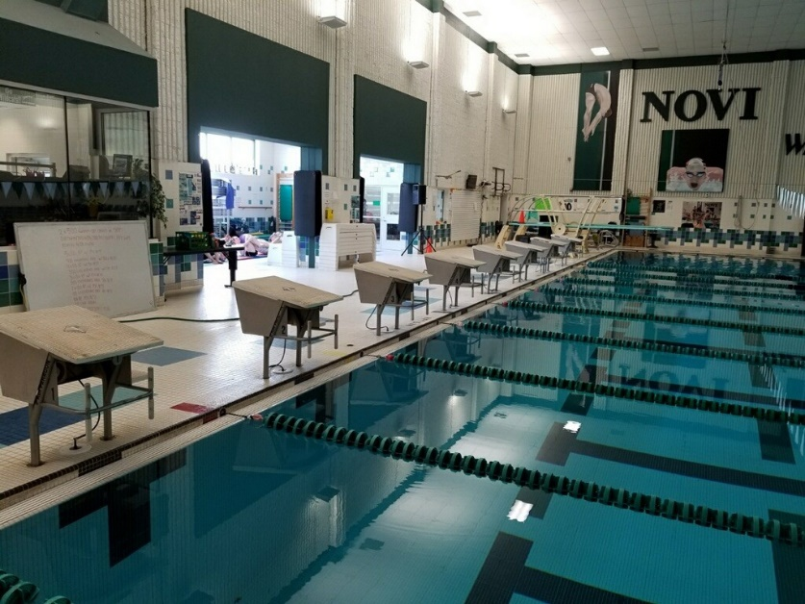
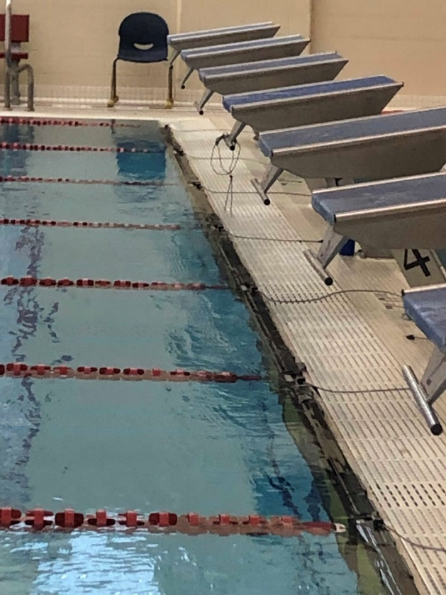
finishes 8-1-7, 8-2-1g, 8-2-2h, 8-2-3g, 8-2-4e
Rule 1-1-1: The end walls are the walls perpendicular to the race course.
Notes:
Rule 1-1-1: The end walls are the walls perpendicular to the race course.
Rationale: When competitor makes contact with the touchpad or end wall in accordance with the requirements of the stroke being swum, the race is completed. Contact with the end wall is interpreted as contact with any structure at the end of the course (deck wall above the gutter, starting block, back of the gutter). There are a variety of pool configurations, and end walls. If some part of the end wall is contacted, and the touchpad is not activated, timers should use backup watch times. Timers shall not stop their watches until the competitor touches the touchpad, end wall or any solid structure at the end of the course.
Use backup times:
A swimmer touches a non-sensitive area of the touchpad A swimmer touches the touchpad but not hard enough to activate the touchpad A swimmer misses the touchpad but touches the end wall in accordance with the stroke A swimmer touches the end wall above the gutter and touchpad
A swimmer touches the starting block wall above the gutter and touchpad A backstroke swimmer finishes in the recessed portion of the gutter

Slide 15
finishes 8-1-7, 8-2-1g, 8-2-2h, 8-2-3g, 8-2-4e
Rule 8-2-1g
The backstroke finish requires completion of the required distance and contact with the touchpad or finish end by any part of the swimmer with some part of the body at or above the surface.
Rule 8-2-2h The breaststroke finish requires completion of the required distance and contact with the touchpad or finish end with both hands simultaneously, not necessarily on the same plane.
Notes:
Rule 8-2-1g
The backstroke finish requires completion of the required distance and contact with the touchpad or finish end by any part of the swimmer with some part of the body at or above the surface.
Rule 8-2-2h The breaststroke finish requires completion of the required distance and contact with the touchpad or finish end with both hands simultaneously, not necessarily on the same plane.
Rationale: Competitors are required to make contact with the touchpad or finish end in the manner prescribed by the stroke being swum. For example, In the backstroke, the competitor shall remain on the back during the finish.

Slide 16
finishes 8-1-7, 8-2-1g, 8-2-2h, 8-2-3g, 8-2-4e
Rule 8-2-3g The butterfly finish requires completion of the required distance and contact with the touchpad or finish end with both hands simultaneously, not necessarily on the same plane.
Rule 8-2-4e The freestyle finish requires completion of the required distance and contact with the touchpad or the finish end by any part of the swimmer.
Notes:
Rule 8-2-3g The butterfly finish requires completion of the required distance and contact with the touchpad or finish end with both hands simultaneously, not necessarily on the same plane.
Rule 8-2-4e The freestyle finish requires completion of the required distance and contact with the touchpad or the finish end by any part of the swimmer.
Rationale: Again, in the butterfly and the freestyle, competitors are required to make contact with the touchpad or finish end. All specific rules applicable to the stroke being swum must be adhered to.

Slide 17
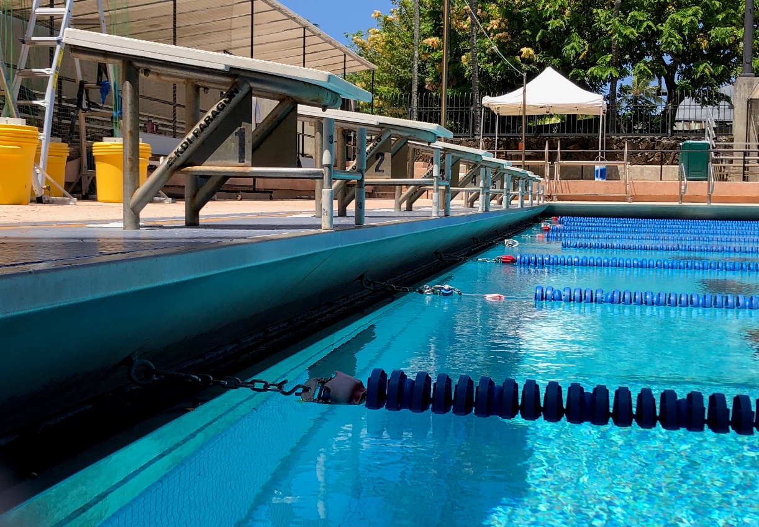
finishes 8-1-7, 8-2-1g, 8-2-2h, 8-2-3g, 8-2-4e, 8-3-5
Rule 8-3-5: Each swimmer of a relay team must contact the finish end at the conclusion of his or her leg of the relay in accordance with the finish rule applicable to the stroke being
swum.
Notes:
Rule 8-3-5: Each swimmer of a relay team must contact the finish end at the conclusion of his or her leg of the relay in accordance with the finish rule applicable to the stroke being swum.
Rationale: Language requiring only the final swimmer to contact the touchpad was removed. The wording was amended to be consistent with the changes to Rule 8-1-7 and requires each swimmer to contact the finish end at the conclusion of his or her leg in accordance with the finish rule applicable to the stroke being swum. Relay takeoff judges will need to be aware that the incoming swimmer has finished his/her leg when ANY structural part of the end of the pool (including starting blocks) is contacted, and the release of the next swimmer must be assessed in that framework. If relay judging equipment is being utilized, there will be no viable data available unless the incoming swimmer activates the touchpad on each exchange.

Slide 18
2019-20 nfhs swimming and diving
Major Editorial Changes

Slide 19
Authorized officials 4-1-2
In championship meets multi-team meets, a meet committee and a meet director shall assume responsibility for all aspects of meet management. The meet committee shall make decisions on matters not specifically covered by the rules or on the misapplication of a rule during a meet. Judgment calls of officials are not subject to review by this committee. The decisions of the meet committee are final.
Notes:
In championship meets multi-team meets, a meet committee and a meet director shall assume responsibility for all aspects of meet management. The meet committee shall make decisions on matters not specifically covered by the rules or on the misapplication of a rule during a meet. Judgment calls of officials are not subject to review by this committee. The decisions of the meet committee are final.
Rationale: The editorial change clarifies that a meet committee and meet director are only required for championship meets. Other meets are administered by the referee or other officials appropriate to the type of meet.

Slide 20
The referee 4-2-2e
During the meet, the responsibilities of the referee are to:
Notify the competitor's coach of an observed violation of 3-3-2 3-3-5 during competition. This may be accomplished with a verbal announcement if the competitor's coach cannot be reached without delay of the meet.
Notes:
During the meet, the responsibilities of the referee are to:
Notify the competitor's coach of an observed violation of 3-3-2 during competition. This may be accomplished with a verbal announcement if the competitor’s coach cannot be reached without delay of the meet.
Rationale: The change in rule reference was a result of the change to Rule 3-3.

Slide 21
2019-20 nfhs swimming and diving
Points of Emphasis

Slide 22
preventing shallow water blackout
How to Avoid Shallow Water Blackout
Never hyperventilate
Never ignore the urge to breathe
Never swim alone
Never play breath holding games
No repetitive underwater laps
Notes:
How to Avoid Shallow Water Blackout
Never hyperventilate
Never ignore the urge to breathe
Never swim alone
Never play breath holding games
No repetitive underwater laps
Rationale: The rules for NFHS swimming and diving exist to ensure fair competition in a positive, safe and healthy environment. Consequently, the NFHS Swimming and Diving Rules Committee recognizes concerns that have been raised over instances of shallow water blackout, otherwise known as hypoxic blackout, which can affect swimmers of all experience levels. Shallow water blackout is a potentially fatal condition that causes a swimmer to lose consciousness while under water. Shallow water blackout can be prevented through education, awareness, and understanding of the dangers of breath-holding. For further information, visit shallowwaterblackoutprevention.org.

Slide 23
suit coverage
Suit Coverage:
Continues to be a focus;
Language addressing coverage and the protocol for addressing violations has been reorganized in the rules book;
Pre-meet coaches and athlete meetings requires the coach to verify that his/her athletes are properly and legally equipped;
Recommend that school administrators and coaches address suit coverage with parents and athletes during their pre-season meetings.
Notes:
Suit Coverage:
Continues to be a focus of administrators, coaches, and officials, and competitors;
Language addressing coverage and the protocol for addressing violations has been reorganized in the rules book;
Pre-meet coaches and athlete meetings requires the coach to verify that his/her athletes are properly and legally equipped;
It is recommended that school administrators and coaches address suit coverage with parents and athletes during their pre-season meetings.
Rationale: Suit coverage continues to be a focus of administrators, coaches, and officials, and competitors. While the rule itself has not changed, language addressing coverage and the protocol for addressing violations has been reorganized in the rules book. In addition, pre-meet coaches and athlete meetings have been mandated, which is an opportunity for the coach to verify that his/her athletes are properly and legally equipped AND an opportunity for captains/peers to consult with their teammates to assure suits and caps meet rule guidelines. It is recommended that coaches address suit coverage with parents and athletes during their pre-season meetings, to specify that suits should be worn as the manufacturer has intended and that athletes purchasing personal suits for competition only obtain suits that comply with NFHS rules regarding appropriate coverage as well as design and decoration.

Slide 24
Accommodations for students with a disability
Accommodations for Students With a Disability Updates:
Updated language for hearing and visual impairments;
Updated images of official’s signals for forward and backstroke starts;
Updated images of modified starting positions;
Available in the 2019 NFHS Swimming Officials Guidelines Manual.
Notes:
Accommodations for Students With a Disability Updates
Updated language for hearing and visual impairments;
Updated images of official’s signals for forward and backstroke starts;
Updated images of modified starting positions;
Available in the 2019 NFHS Swimming Officials Guidelines Manual.
Rationale: Language and officials signals regarding the inclusion of students with a disability have been updated and will be available in the 2019 NFHS Swimming Officials Guidelines Manual. Included are updated images of officials signals for the forward and backstroke start as well as images for modified starting positions. Specific accommodations for visually impaired and hearing-impaired competitors are also provided in this publication.

Slide 25
sub-varsity competition
State associations may modify events and distances for non-varsity competition.
NFHS playing rules are written specifically for varsity competition.
Modifications for levels other than varsity are at the discretion of the state association.
Notes:
State associations may modify events and distances for non-varsity competition.
NFHS playing rules are written specifically for varsity competition.
Modifications for levels other than varsity are at the discretion of the state association.
Rationale: The policy permitting state associations to modify events and distances for non-varsity competition remains in effect (5-1-1 NOTE 1). States have the authority to shorten/lengthen distances and add other events in non-varsity competition. NFHS playing rules are written specifically for varsity competition. Modifications for levels other than varsity are at the discretion of the state association.

Slide 26
pre-meet conference
In situations where conducting a pre-meet conference is impractical:
State associations may determine an alternative method of compliance;
Topics that should be covered are listed in the NFHS Swimming Officials Guidelines Manual;
Must provide appropriate information for athletes, coaches, and meet officials to assure that the stated purposes for the pre-meet conference are met.
Notes:
In situations where conducting a pre-meet conference is impractical:
State associations may determine an alternative method of compliance;
Topics that should be covered are listed in the NFHS Swimming Officials Guidelines Manual;
Must provide appropriate information for athletes, coaches, and meet officials to assure that the stated purposes for the pre-meet conference are met.
Rationale: The mandatory pre-meet conference as applied to large championship or multi-meets can become problematic in some contexts, particularly in large meets. The pre-meet conference is a time to review meet procedures, special instructions and any unusual pool conditions. A comprehensive list of items to be covered is included in Appendix G of the NFHS Swimming Officials Guidelines Manual. State associations may determine an alternative method or methods of communication in situations where the size of the meet makes a pre-meet conference impractical. State associations are encouraged to provide appropriate policy direction for officials and meet administrators in assuring that the stated purposes for this conference are fulfilled and that both coaches and athletes are fully informed and prepared for the ensuing competition.

Slide 27
2019-20 nfhs swimming and diving
Swimming and Diving Reminders

Slide 28
Exhibition competitors 1-2-3, 3-2-1c, 9-3-1
Rule 1-2-3: Exhibition competitors are permitted unless state association policy determines otherwise. An exhibition competitor is a non-scoring contestant in a regularly scheduled and scored event.
Rule 3-1-2c: Each team shall be permitted an equal number of additional entries in a pool with eight lanes or more.
Rule 9-3-1: The number of team entries permitted in swimming and diving events shall be the same.
Notes:
Rule 1-2-3: Exhibition competitors are permitted unless state association policy determines otherwise. An exhibition competitor is a non-scoring contestant in a regularly scheduled and scored event.
Rule 3-1-2c: Each team shall be permitted an equal number of additional entries in a pool with eight lanes or more.
Rule 9-3-1: The number of team entries permitted in swimming and diving events shall be the same.
Exhibition Reminders: Rule 1-2-3 tells us that exhibition competitors may participate in a scored event, and Rule 3-1-2c states that with prior mutual consent, each team shall be permitted as many additional entries as may be equally provided for both teams, in a pool with eight lanes or more. For example, in an eight-lane pool, if each team is permitted three scoring individual entries, one exhibition competitor from each team could be permitted to participate to fill eight lanes.
State associations may also permit additional heats of exhibition competitors. When additional heats of exhibition competitors are permitted by state association policy, additional participants may be permitted in diving.
Additionally, Rule 9-3-1 also addresses team entries by stating that the number of team entries in diving competition shall be the same as in the swimming events for that meet. In the scenario just described, three scoring divers and one exhibition diver could participate.

Slide 29
NFHS OFFICIALS Education

Slide 30
SPORTS-SPECIFIC Officiating COURSES www.nfhslearn.com
Introduction to mechanics and techniques used in each sport
Ideal for new officials or those in first few years of officiating
30-45 minutes to complete
Topics vary based on the needs of the officials in the sport
NFHS Officials Association members cost is $10
Non-members - course is $20
API available to state associations to collect results
Notes:
SPORTS-SPECIFIC OFFICIATING COURSES
Introduction to mechanics and techniques used in each sport
Ideal for new officials or those in first few years of officiating
30-45 minutes to complete
Topics vary based on the needs of the officials in the sport
Course is FREE to any NFHS Officials Association member
Non-members course is $20
Contact NFHS Officials Department for details (317.972.6900)

Slide 31
NFHS OFFICIALS EDUCATION SPORT-SPECIFIC COURSES
Courses Available
Officiating Football
Soccer – Fouls and Misconduct
Swimming and Diving
Officiating Wrestling
Officiating Basketball
Umpiring Softball
Officiating Volleyball – Ball Handling
Future Courses
Officiating Baseball
Basketball – Three-Person Mechanics
Field Hockey
Track and Field
Volleyball – Overlapping
Softball – Mechanics
Communication Among Officials and Coaches
Soccer - Offside
Notes:
NFHS OFFICIAL EDUCATION
Courses Available
Officiating Football
Soccer – Fouls and Misconduct
Swimming and Diving
Officiating Wrestling
Officiating Basketball
Umpiring Softball
Officiating Volleyball – Ball Handling
Future Courses
Officiating Baseball
Basketball – Three-Person Mechanics
Field Hockey
Track and Field
Volleyball – Overlapping
Softball – Mechanics
Communication Among Officials and Coaches
Soccer - Offside

Slide 32
Interscholastic Officiating www.nfhslearn.com
Introduction to skills and concepts used as an official
Ideal for new officials or those in first few years of officiating
30-45 minutes to complete
Topics include: basics of becoming and staying an official, science of officiating, art of officiating, how to combine these skills for successful officiating
Course is FREE to any NFHS Officials Association member
Non-members course is $20
API available to state associations to collect results
Notes:
The Interscholastic Officiating Course contains the following information:
Introduction to skills and concepts used as an official
Ideal for new officials or those in first few years of officiating
30-45 minutes to complete
Topics include: basics of becoming and staying an official, science of officiating, art of officiating, how to combine these skills for successful officiating
Course is FREE to any NFHS Officials Association member
Non-members course is $20
API available to state associations to collect results

Slide 33
Notes:
VIDEO FOR TEACHING AND LEARNING
The new video library is located at www.nfhslearn.com
A variety of video in many sports is provided.

Slide 34
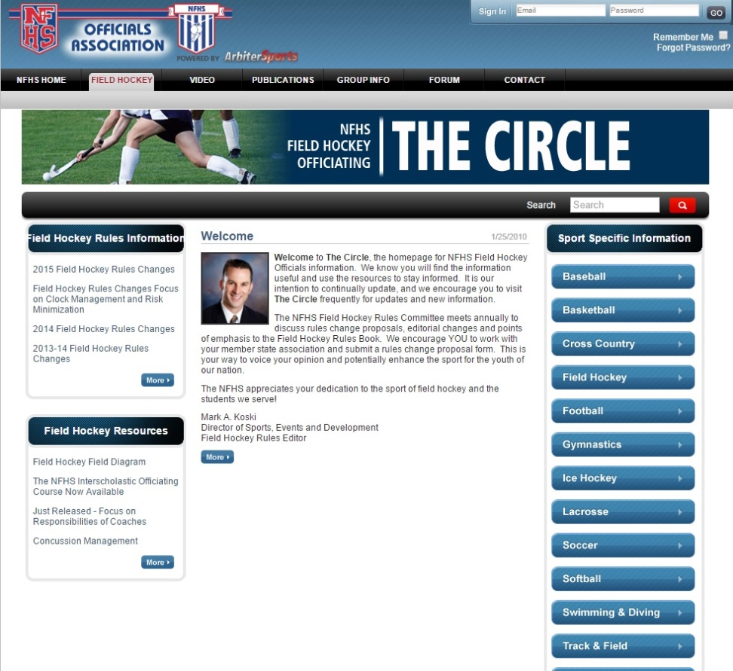
NFHS Officials Association Central Hub
https://nfhs-fieldhockey.arbitersports.com/front/105408/Site
Contains:
Sport information
Rules information
Rules library
Searchable rules book
Video content on officiating sport, competition situations and interpretations
Notes:
State associations with 100% membership in the NFHS Officials Association and any individual member has access to the Central Hub for officials.

Slide 35
NFHS Learning Center

Slide 36
Nfhs learning center www.nfhslearn.com
Over 1.6 Million courses delivered in 2018
Over 8.2 Million courses since 2007 launch
Over 70 courses available
Over 35 at No Cost!
Notes:
Over 1.6 Million courses delivered in 2018
Over 8.2 Million courses since 2007 launch
Over 70 courses available
Over 35 at No Cost!

Slide 37
www.nfhslearn.com
FREE courses include:
Bullying, Hazing and Inappropriate Behaviors
Student Mental Health and Suicide Prevention
Understanding Copyright and Compliance
Protecting Students from Abuse
Hazing Prevention for Students
Coaching Unified Sports
ACL Injury Prevention
Sportsmanship
And many more
Notes:
FREE courses include:
Bullying, Hazing and Inappropriate Behaviors
Student Mental Health and Suicide Prevention
Understanding Copyright and Compliance
Protecting Students from Abuse
Hazing Prevention for Students
Coaching Unified Sports
ACL Injury Prevention
Sportsmanship
And many more

Slide 38
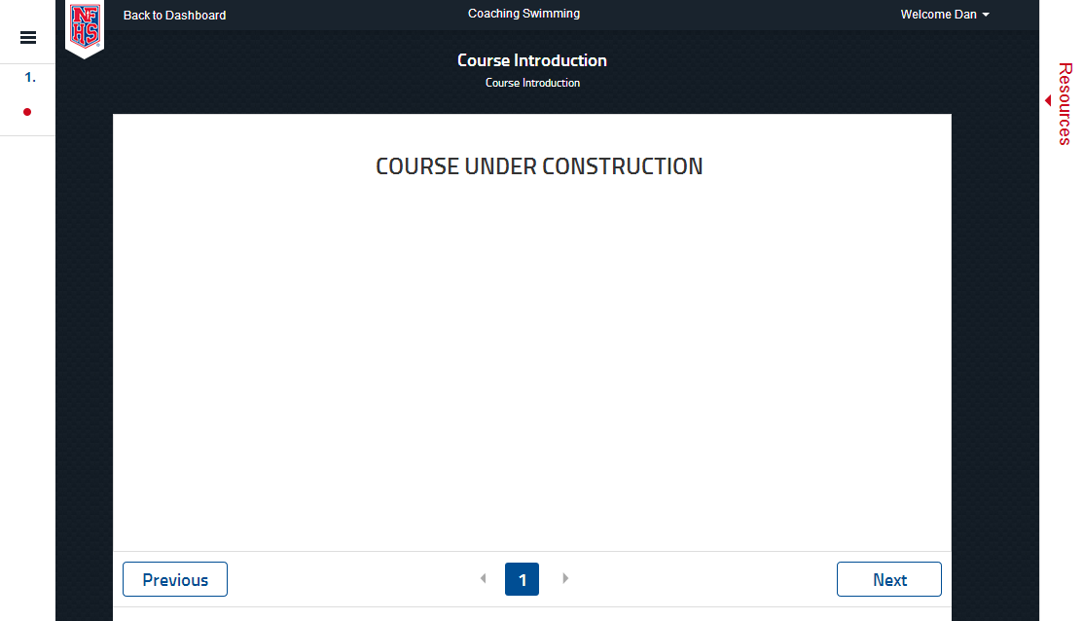
Coaching Swimming
Developed with NISCA
Notes:
The NFHS is pleased to partner with the National Interscholastic Swim Coaches Association to present the online Coaching Swimming course. Go to www.nfhslearn.com to view the trailer, description and outline for this course. Encourage your coaches to sign-up today!

Slide 39
Officiating Swimming & Diving
Course Objectives
Units
Understand the roles of professionalism, rules knowledge, and communication and how they help ensure a fair meet.
Know how to consistently identify swimming violations in each type of event.
Learn the elements of a proper dive and how to score dives appropriately.
Elements of Professional Development
Officiating Swimming
Officiating Diving
Judging Practicum
Unlimited access to course for 1 year from the date of purchase
Approved by NFHS for 3 course clock hours
Notes:
Officiating Swimming and Diving is a course developed by the NFHS in conjunction with the National Interscholastic Swim Coaches Association (NISCA) and USA Diving. This course defines the elements of professional development and the fundamentals of officiating strokes and turns. The course also explores officiating and judging diving and provides a judging practicum that includes feedback of submitted scores. Officials may select either the swimming track, the diving track, or both, depending on rules required by their state association.
More:
- Unlimited access to course & resources for one year from date of purchase
- Use as an elective to fulfill AIC or CIC certification requirements

Slide 40
2019-20 nfhs swimming and diving
Resources

Slide 41
Nfhs Swimming and Diving Officials’ Guidelines Manuals
The revised manuals will be available August 1 on the following website locations:
http://www.nfhs.org/activities-sports/swimming-diving/ https://arbitersports.com

Slide 42
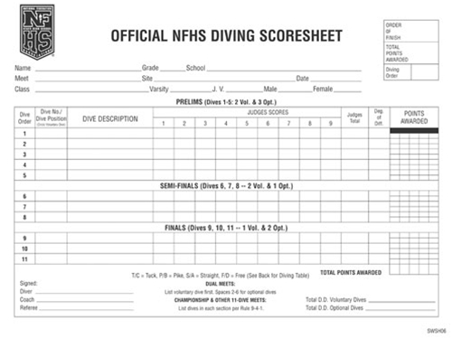
Nfhs Swimming and Diving publications
The Rules Book, Scorebook and other swimming and diving materials can be ordered online at www.nfhs.com, or by calling 1-800-776-3462.
Notes:
The NFHS swimming and diving publications are available to order online or by using the toll free number.

Slide 43
Thank You
National Federation of State High School Associations PO Box 690 | Indianapolis, IN 46206 Phone: 317-972-6900 | Fax: 317.822.5700 www.nfhs.org | www.nfhslearn.com

